Slide 1





Institute of Informatics & Communication
M.Sc. Informatics, Batch 2022-2024
ITCC - 403 Project (Semester - IV)
MANUSCRIPT MANAGEMENT SYSTEM
Prepared by
BHARAT AGGARWAL
ROLL NO - 22285756008
InReview Web App

Slide 2
Table Of Content
Objective
Workflow and SS
Conclusions
01
03
05
Discussed about the Introduction and objective of this project.
Fill in the following text
fields with appropriate
explanations.
Fill in the following text
fields with appropriate
explanations.
Project Modules
Technology Stack Used
Future Scope
02
04
06
Discussed about the main modules that project includes.
Fill in the following text
fields with appropriate
explanations.
Fill in the following text
fields with appropriate
explanations.

Slide 3

About The Project
Objective
In today’s fast-paced technological landscape, managing academic and professional events like conferences, journals, and hackathons efficiently has become crucial. To meet this challenge, we propose the creation of an advanced web application called the “Manuscript Management System.”
The objective of the Manuscript Management System is to provide a comprehensive, user-friendly platform that enhances the organization and management of academic and professional events. By streamlining event registration, submission management, and the review process, the system aims to facilitate efficient interactions among event organizers, participants, and reviewers. It seeks to ensure the integrity and quality of submissions through a multilevel approval hierarchy, ultimately promoting transparency, collaboration, and innovation within the academic and professional communities.

Slide 4
About The Project
Objective
Event organizers can effortlessly create and manage their events, inviting reviewers and status tracking, while participants benefit from an intuitive interface that enables easy registration, document submission or resubmission, and real-time tracking of their submission status. Admin oversee event approval requests, generating unique invite links for reviewers and reviewer profiles requests. Reviewers are provided with a structured and streamlined process to evaluate submissions thoroughly.
Key features include event registration, submission management, reviewer invitation, and status tracking, all integrated into a cohesive system designed to enhance transparency and efficiency.

Slide 5

Project Modules
- Event Module:
User-friendly event registration and submission process.
Approval workflow for event validation by administrators.
- Reviewer Module:
Invitation system for administrators to invite qualified reviewers.
Manual verification of reviewer profiles for credibility.
- Document Management:
Assignment of submitted documents to reviewers.
Multilevel approval process for in-depth scrutiny.
- Notification System:
Automated emails for event approval, reviewer invitations, and document status updates.
- Dashboards:
Dashboards for every user to provide an overview of ongoing events and registered events for participants, events organized by organizers and reviewer dashboard for event invitation, pending and completed tasks.
- Security Measures:
User authentication and authorization.
Safeguards to protect the confidentiality and integrity of submitted documents.
- Target Users:
Admin, Event Organizers, Reviewers, and Participants.

Slide 6
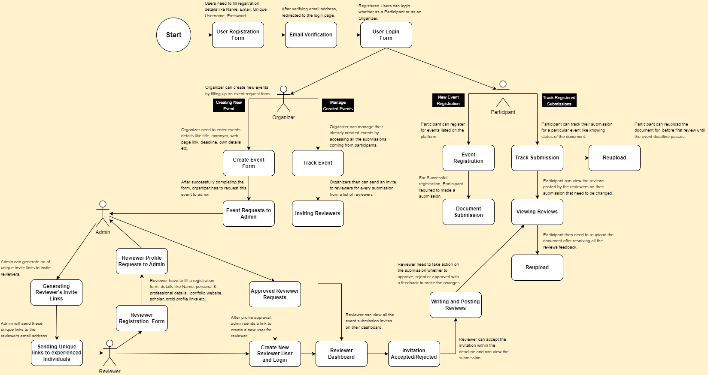
Application Workflow
https://app.diagrams.net/#G15mkAYYSEtnS2Hm08JMFpAdOrRHgdu6GH#%7B%22pageId%22%3A%22uc6QEzXxf6h0OyHBWag-%22%7D

Slide 7
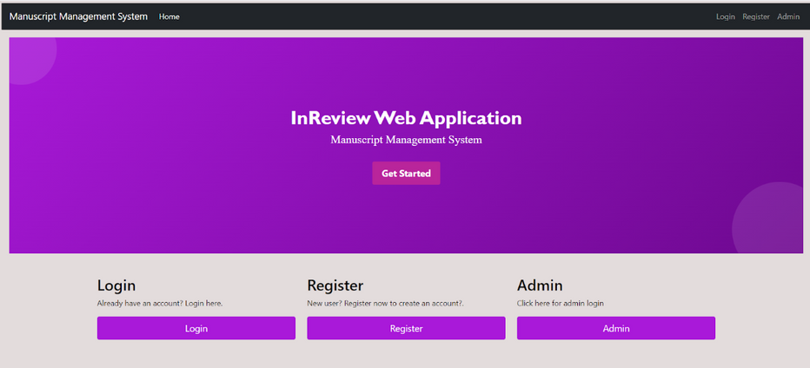
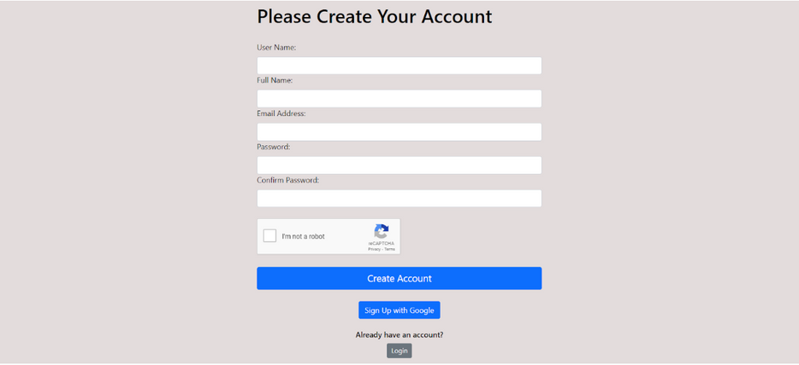
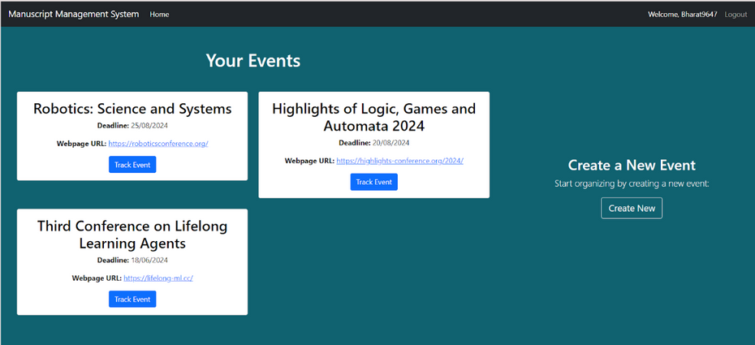
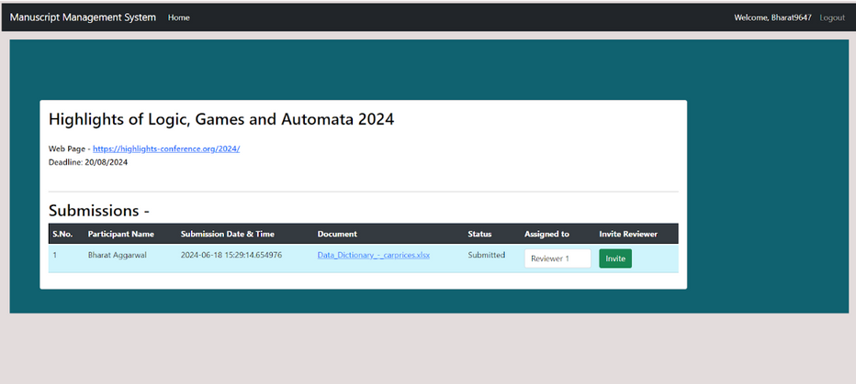
Application Screenshots
Home Page
Registrartion Form
Organizer’s Dashboard
Organizer’s Track Event Page

Slide 8
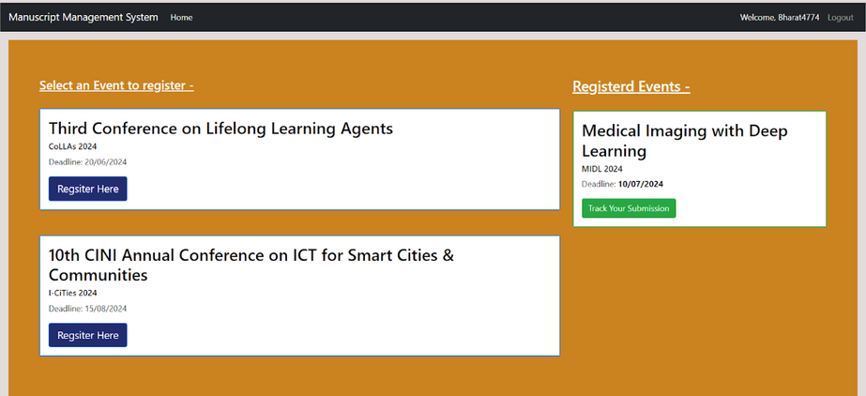
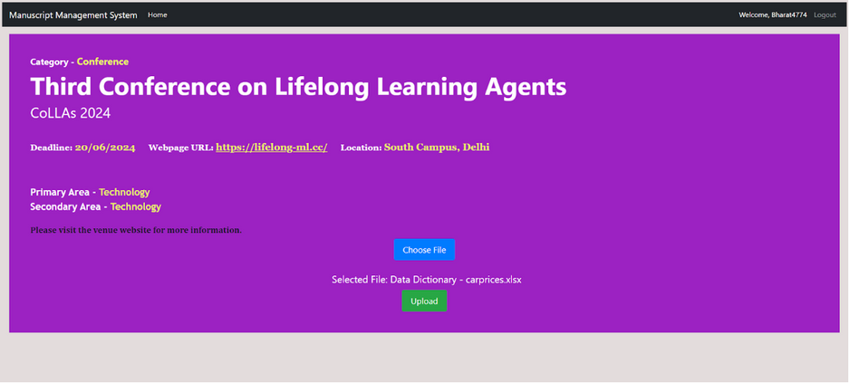
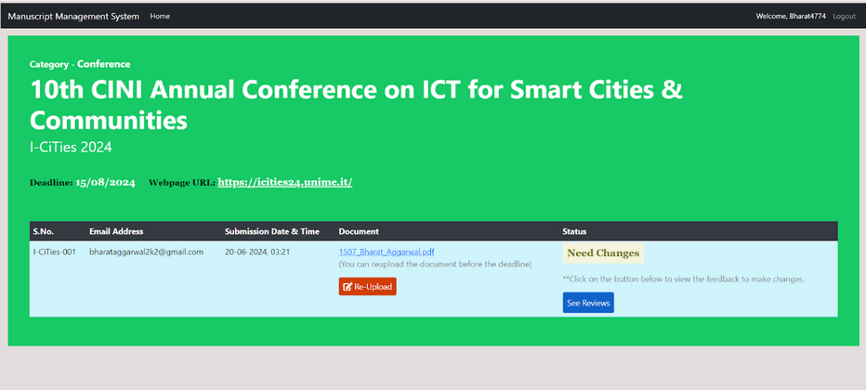
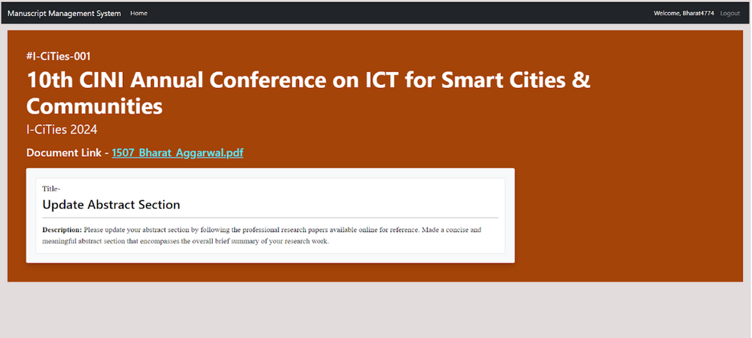
Application Screenshots
Participant’s Dashboard
Document Submission Page
Submission Tracking Page
Submission Reviews Page

Slide 9
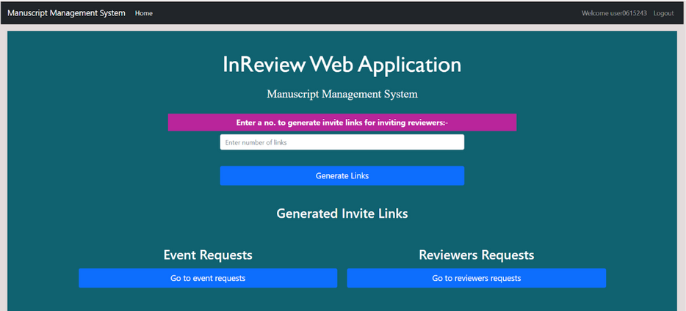
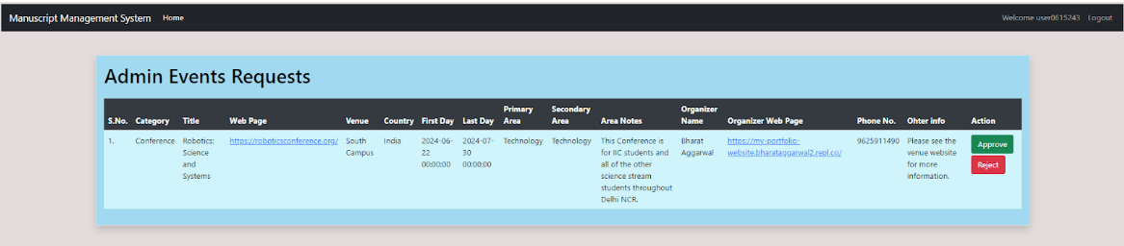
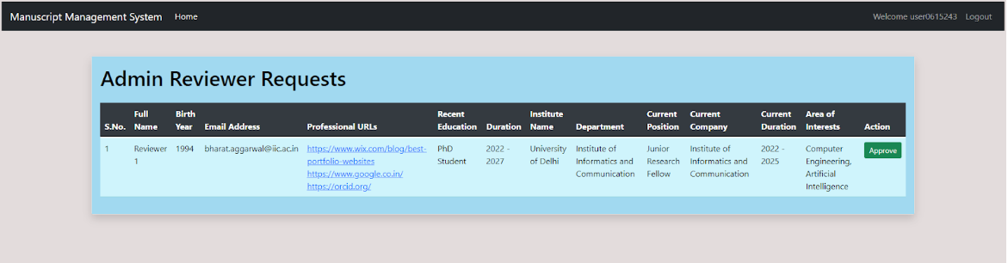
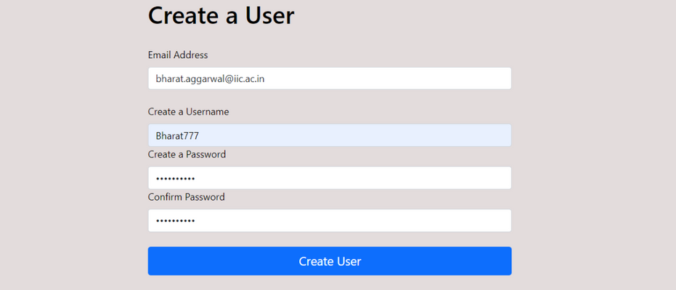
Application Screenshots
Admin’s Dashboard
Admin’s Event Requests Page
Admin’s Reviewers Requests Page
Reviewer’s Create New User Page

Slide 10
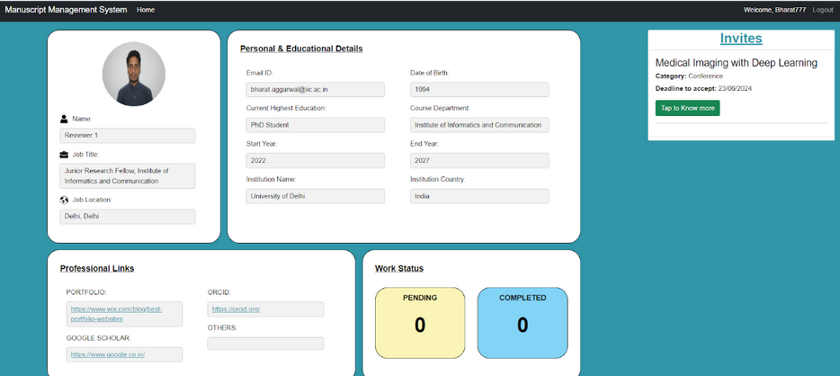
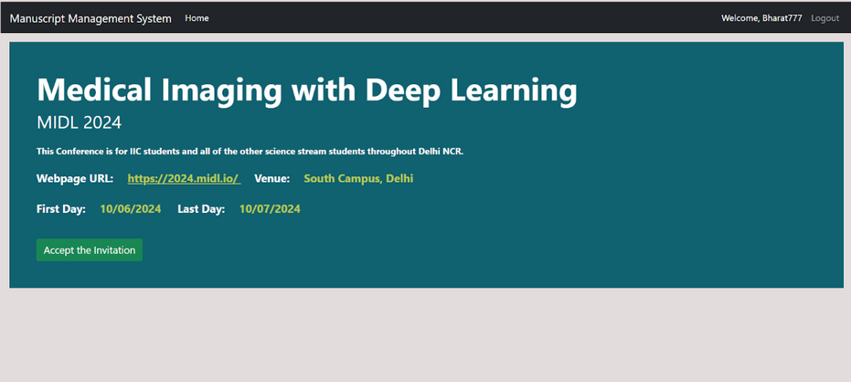
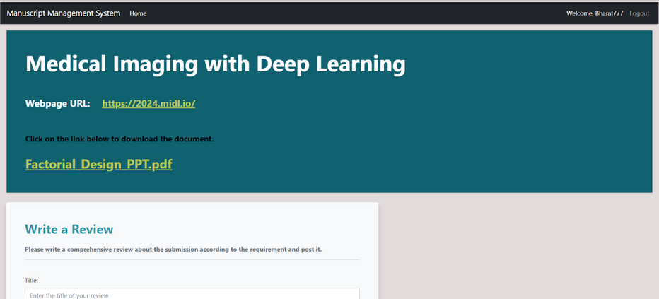
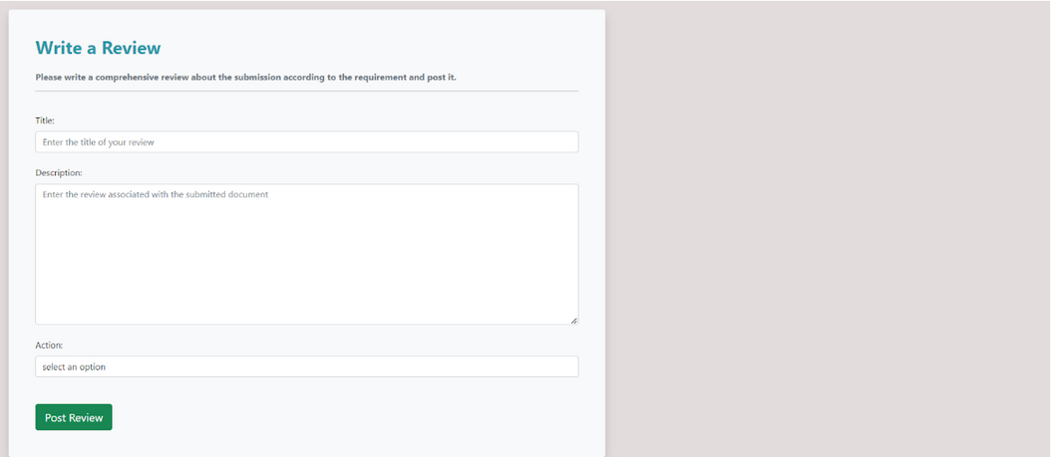
Application Screenshots
Reviewers Dashboard
Reviewers Invitations Page
Document View Page
Write Review Page

Slide 11


Technology Stack Used
Frontend Technologies - HTML, CSS, Bootstrap CSS and JavaScript.
Backend Technologies - Python, Flask Framework.
Security - Used Hashing to store and retrieve passwords securely.
APIs Used -
Flask-Mail - Used Google SMTP server for sending emails.
Google ReCAPTCHA - Used Google ReCAPTCHA for bot prevention during form validations.
Google OAuth 2.O - Used for authenticating users via a google account.
Database - SQLite using SQLAlchemy ORM
Deployment - Running locally on Flask Server.

Slide 12

Future Scope
Reviewer Rating and Feedback System:
Introduce a rating system for reviewers based on their performance and reliability.
Collaborative Reviewing:
Allowing multiple reviewers to collaborate on the evaluation of a single submission. This feature can foster discussions and diverse perspectives during the review process.
Document Versioning and History:
Implement a versioning system for submitted documents, allowing participants to track changes and updates. Maintain a history log to record all modifications, providing a comprehensive overview of document evolution throughout the review process as revision documents.
Multi Level Approval Hierarchy:
Implement a multi level scrutiny process for the submissions that is handled by the event organizers to ask participants to reupload the documents after one level of review is done and this hierarchy continues upto a certain level until the document is successfully accepted by a required no of reviewers.

Slide 13

Conclusion
The Manuscript Management System project represents a significant advancement in the management of academic and professional events such as conferences, journals, and hackathons. By integrating a wide array of backend technologies, the system ensures robust functionality, security, and user-friendliness, making it an indispensable tool for event organizers, participants, and reviewers.
Overall, the Manuscript Management System is designed to facilitate the efficient execution of events, fostering collaboration and innovation within the academic and professional communities. With its intuitive interface and comprehensive feature set, this system stands as a powerful solution to the challenges of event management, promoting excellence and efficiency in the organization and participation of academic and professional events.
Aaron Loeb
Alfredo Torres
Bailey Dupont

Slide 14
THANK YOU
FOR YOUR ATTENTION

